Slide 1

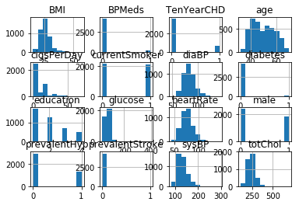
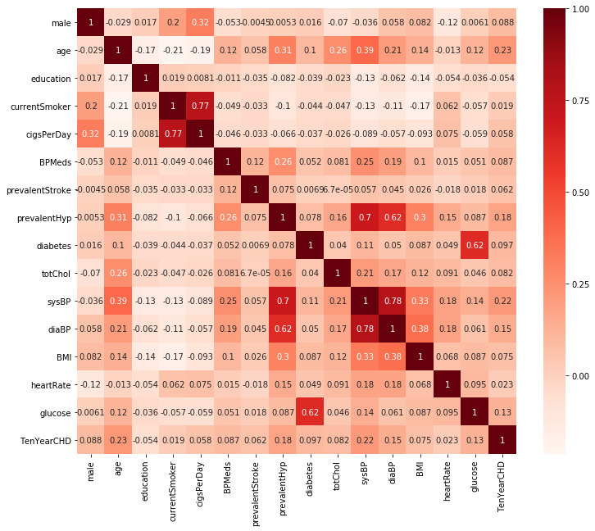
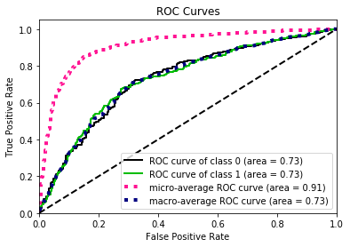


Prediction of CHD using Machine learning
Abstract
Results
Artificial intelligence (AI) aims to mimic human cognitive functions. It is bringing a paradigm shift to healthcare, powered by increasing availability of healthcare data and rapid progress of analytics techniques. AI can be applied to various types of healthcare data (structured and unstructured). Major disease areas that use AI tools include cancer, neurology and cardiology. This project aims to see how AI applications can help in early detection of Coronary Heart disease. In this project various Supervised Learning techniques have been used to predict Coronary Heart Disease. A real dataset from Framingham Heart Study (FHS) has been used. It includes over 4000 records and of 15 attributes.
In this project supervised techniques like Random Forest classifier, Decision Tree, SVM, Logistic Regression to detect the class variable. We found logistic regression to be better with 85% accuracy.
The project used 67% of data to train the model and remaining 33% dataset wasused for testing. Different classifiers were analyzed, but basis the accuracy and performance it was found that Logistic Regression achieved an accuracy of 85% with sensitivity and specificity of 6.1% and 99% respectively. The ROC curve representing robustness of the classifier is shown in Fig.3. Fig. 4 represents model wise performance. Fig. 2 represent the coorelation between the features and the class variable
Attribute | correlation
age | 0.23
sysBP | 0.22
prevalentHyp | 0.18
diaBP | 0.15
glucose | 0.13
Introduction
World Health Organization has estimated 12 million deaths occur worldwide, every year due to Heart diseases. In our day to day life, people are undergoing a routine and busy schedule which leads to stress and anxiety. In addition to this, the percentage of people who are obese and addicted to cigarette is going up drastically. This leads to various lifestyle diseases like heart disease, cancer etc. The challenge behind these diseases is its prediction, as their is no robust methodology to predict these diseases in mid 20s and 30s. A large amount of work has been done related to heart prediction system by using various techniques and algorithms by many people. The aim of the current project is to achieve better accuracy, so that it can predict the chances of heart attack.
Figure 1. Data set
Important features (top 5)
Objectives
1. To automate prediction of Coronary Heart Disease by using Machine learning classification techniques.
2. To analyze the most important features that affects heart disease
3. To evaluate Weka Machine learning software for analysis, predictions and pattern mining in above setting.
Figure 2. Classifier results on test set
 | LR | XG Boost | Random Forest | SVM | Decision Tree
Precision | 0.82 | 0.81 | 0.81 | 0.72 | 0.79
Recall | 0.85 | 0.85 | 0.85 | 0.85 | 0.79
F1-score | 0.8 | 0.79 | 0.8 | 0.78 | 0.79
Support | 1399 | 1399 | 1399 | 1399 | 1399
Accuracy | 85% | 85% | 85% | 85% | 79%
AUC | 91% | 91% | 90% | 88% | 79%
True +ve | 13 | 3 | 16 | 0 | 60
True -ve | 1181 | 1187 | 1175 | 1189 | 1039
False +ve | 8 | 2 | 14 | 0 | 150
False -ve | 197 | 207 | 194 | 210 | 150
Methodology
Investigate a suite of complex models and establish a performance ceiling:
Support Vector Machines
Gradient Boosting Machines
Random Forest
Bagged Decision Trees
Investigate a suite of simpler more interpretable models, such as:
Logistics Regression
k-Nearest Neighbours.
Select the model from (1) & (2) that best approximates the accuracy.
Figure 3.ROC curve
Figure 4. Comparison of various models
Conclusions
This project highlighted how Machine Learning techniques can be used to detect disease at early stage of ones life. Some of the most useful algorithms and techniques of artificial intelligence which are used. In recent years several studies carried out in artificial intelligence subject on heart patients’ data, and many of algorithms were successful. But the important point is that the level of success in these algorithms depends on various factors and it is not possible to choose a method as the best one. Factors like data type of database, selecting sub-set of properties and risk factors, number of properties, the larger size of database, low number of missed data and access to suitable and correct data increases the success chance in exploration and increase the quality of algorithms’ results.
Contact
Sagar Yadav

